Slide 1
Chapter 7 Memory Management

Slide 2
CS 345
Stalling’s Chapter | # | Project
1: Computer System Overview 2: Operating System Overview | 4 | P1: Shell
3: Process Description and Control 4: Threads | 4 | P2: Tasking
5: Concurrency: ME and Synchronization 6: Concurrency: Deadlock and Starvation | 6 | P3: Jurassic Park
7: Memory Management 8: Virtual memory | 6 | P4: Virtual Memory
9: Uniprocessor Scheduling 10: Multiprocessor and Real-Time Scheduling | 6 | P5: Scheduling
11: I/O Management and Disk Scheduling 12: File Management | 8 | P6: FAT
Student Presentations | 6

Slide 3
Chapter 7 Learning Objectives
After studying this chapter, you should be able to:
Discuss the principal requirements for memory management.
Understand the reason for memory partitioning and explain the various techniques that are used.
Understand and explain the concept of paging.
Understand and explain the concept of segmentation.
Assess the relative advantages of paging and segmentation.
Summarize key security issues related to memory management.
Describe the concepts of loading and linking.

Slide 4
Memory Management Requirements
Requirements
Relocation
Users generally don’t know where they will be placed in main memory
May swap in at a different place (pointers???)
Generally handled by hardware
Protection
Prevent processes from interfering with the O.S. or other processes
Often integrated with relocation
Sharing
Allow processes to share data/programs
Logical Organization
Support modules, shared subroutines
Physical Organization
Main memory verses secondary memory
Overlaying

Slide 5
Address Binding
source
A process must be tied to a physical address at some point (bound)
Binding can take place at 3 times
Compile time
Always loaded to same memory address
Load time
relocatable code
stays in same spot once loaded
Execution time
may be moved during execution
special hardware needed
Compiler/Assembler
object
Linker
load module
Loader
Executable

Slide 6
Memory Management Techniques
Fixed Partitioning
Divide memory into partitions at boot time, partition sizes may be equal or unequal but don’t change
Simple but has internal fragmentation
Dynamic Partitioning
Create partitions as programs loaded
Avoids internal fragmentation, but must deal with external fragmentation
Simple Paging
Divide memory into equal-size pages, load program into available pages
No external fragmentation, small amount of internal fragmentation

Slide 7
Memory Management Techniques
Simple Segmentation
Divide program into segments
No internal fragmentation, some external fragmentation
Virtual-Memory Paging
Paging, but not all pages need to be in memory at one time
Allows large virtual memory space
More multiprogramming, overhead
Virtual Memory Segmentation
Like simple segmentation, but not all segments need to be in memory at one time
Easy to share modules
More multiprogramming, overhead

Slide 8
1. Fixed Partitioning
Fixed Partitioning
Main memory divided into static partitions
Simple to implement
Inefficient use of memory
Small programs use entire partition
Maximum active processes fixed
Internal Fragmentation
Operating System
8 M
8 M
8 M
8 M
8 M

Slide 9
Fixed Partitioning
Fixed Partitioning
Variable-sized partitions
assign smaller programs to smaller partitions
lessens the problem, but still a problem
Placement
Which partition do we use?
Want to use smallest possible partition
What if there are no large jobs waiting?
Can have a queue for each partition size, or one queue for all partitions
Used by IBM OS/MFT, obsolete
Smaller partition by using overlays
Operating System
8 M
2 M
4 M
6 M
8 M
8 M
12 M

Slide 10
Placement Algorithm w/Partitions
Fixed Partitioning
Equal-size partitions
because all partitions are of equal size, it does not matter which partition is used
Unequal-size partitions
can assign each process to the smallest partition within which it will fit
queue for each partition
processes are assigned in such a way as to minimize wasted memory within a partition

Slide 11
Process Queues
Fixed Partitioning
When its time to load a process into main memory the smallest available partition that will hold the process is selected
Operating
System
Operating
System
New
Processes
New
Processes

Slide 12
2. Dynamic Partitioning
Dynamic Partitioning
Partitions are of variable length and number
Process is allocated exactly as much memory as required
Eventually get holes in the memory.
external fragmentation
Must use compaction to shift processes so they are contiguous and all free memory is in one block

Slide 13
Allocation Strategies
Dynamic Partitioning
First Fit
Allocate the first spot in memory that is big enough to satisfy the requirements.
Best Fit
Search through all the spots, allocate the spot in memory that most closely matches requirements.
Next Fit
Scan memory from the location of the last placement and choose the next available block that is large enough.
Worst Fit
The largest free block of memory is used for bringing in a process.

Slide 14
Which Allocation Strategy?
Dynamic Partitioning
The first-fit algorithm is not only the simplest but usually the best and the fastest as well.
May litter the front end with small free partitions that must be searched over on subsequent first-fit passes.
The next-fit algorithm will more frequently lead to an allocation from a free block at the end of memory.
Results in fragmenting the largest block of free memory.
Compaction may be required more frequently.
Best-fit is usually the worst performer.
Guarantees the fragment left behind is as small as possible.
Main memory quickly littered by blocks too small to satisfy memory allocation requests.

Slide 15
Dynamic Partitioning Placement Algorithm
Dynamic Partitioning
8K
8K
12K
12K
Allocate 18K
First Fit
Next Fit
Best Fit
22K
6K
Last
allocated
block (14K)
18K
2K
8K
8K
6K
6K
14K
14K
36K
20K
Allocated block
Free block
Before
After
Notes:
Next fit and First fit are the same be have different starting points
Why worse fit? Keeps from making small fragments.
First fit, next fit – fast.
After tons of analysis – all algorithms seem to work equally well. So, we usually choose first fit.

Slide 16
Memory Fragmentation
Dynamic Partitioning
As memory is allocated and deallocated fragmentation occurs
External -
Enough space exists to launch a program, but it is not contiguous
Internal -
Allocate more memory than asked for to avoid having very small holes

Slide 17
Memory Fragmentation
Dynamic Partitioning
Statistical analysis shows that given N allocated blocks, another 0.5 N blocks will be lost due to fragmentation.
On average, 1/3 of memory is unusable
(50-percent rule)
Solution – Compaction.
Move allocated memory blocks so they are contiguous
Run compaction algorithm periodically
How often?
When to schedule?
Notes:
Whole lot better than fixed partitioning

Slide 18
Buddy System
Dynamic Partitioning
Tries to allow a variety of block sizes while avoiding excess fragmentation
Blocks generally are of size 2^{k}, for a suitable range of k
Initially, all memory is one block
All sizes are rounded up to 2^{s}
If a block of size 2^{s} is available, allocate it
Else find a block of size 2^{s+1} and split it in half to create two buddies
If two buddies are both free, combine them into a larger block
Largely replaced by paging
Seen in parallel systems and Unix kernel memory allocation

Slide 19
Address Translation

Slide 20
Address Types
Programmers refer to a memory address (address space) as the way to access a memory cell (addressability).
Logical (relative)
Reference to a memory location independent of the current assignment of data to physical memory
Consists of a segment and an offset
Linear (virtual)
Address expressed as a location relative to some known base address
Mapped via segmentation
Physical (memory bus)
The absolute address or actual memory location
Mapped via paging

Slide 21
Hardware Support for Relocation
Logical address
Process Control
Block
Base Register
Adder
Physical
address
Program
Comparator
Interrupt to
operating system
Data / Stack
Bounds Register
Kernel Stack
Process image in
main memory

Slide 22
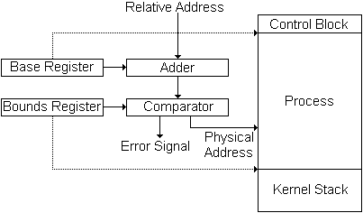
Base/Bounds Relocation
Base Register
Holds beginning physical address
Add to all program addresses
Bounds Register
Used to detect accesses beyond the end of the allocated memory
May have length instead of end address
Provides protection to system
Easy to move programs in memory
These values are set when the process is loaded and when the process is swapped in
Largely replaced by paging

Slide 23
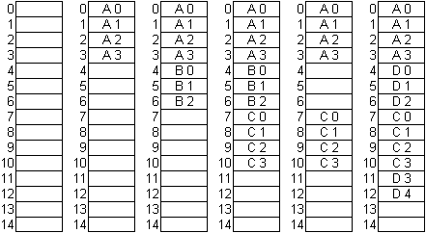
3. Simple Paging
Simple Paging
Partition memory into small equal-size chunks and divide each process into the same size chunks
The chunks of a process are called pages and chunks of memory are called frames
Operating system maintains a page table for each process
contains the frame location
for each page in the process
memory address consist of a
page number and offset
within the page
Notes:
Use loose-leaf / bound book analogy
Linux runs at 2k page size

Slide 24
Paging (continued…)
Simple Paging
Page size typically a power of 2 to simplify the paging hardware
Example (16-bit address, 1K pages)
010101 011011010
Top 6 bits (010101)= page #
Bottom 10 bits (011011010) = offset within page
Common sizes: 512 bytes, 1K, 4K
A
B
C
D
Free
0
-
7
4
13
1
-
8
5
14
2
-
9
6
3
10
11
12

Slide 25
Paging
Simple Paging
Frame
Number
0
A.0
0
0
0
7
13
1
A.1
1
1
1
8
14
2
A.2
2
2
2
9
Free Frame List
3
A.3
3
3
3
10
4
B.0
D.0
Process A
Process C
5
B.1
D.1
6
B.2
D.2
0
0
4
0
4
7
C.0
---
1
1
5
1
5
8
C.1
---
2
2
6
2
6
9
C.2
---
Process B
3
11
10
C.3
Process B
11
D.3
4
12
12
D.4
Process D
13
14

Slide 26
4. Simple Segmentation
Simple Segmentation
Program views memory as a set of segments of varying sizes
Supports user view of memory
Easy to handle growing data structures
Easy to share libraries, memory
Privileges can be applied to a segment
Programs may use multiple segments
Implemented with segmentation tables
Array of base-limit register pairs
Beginning address (segment base)
Size (segment limit)
Status bits (Present, Modified, Accessed, Permission, Protection)

Slide 27
Simple Segmentation
Simple Segmentation
A logical address consists of two parts: a segment identifier and an offset that specifies the relative address within the segment.
The segment identifier is a 16-bit field called the Segment Selector, while the offset is a 32-bit field.
To make it easy to retrieve segment selectors quickly, the processor provides segmentation registers whose only purpose is to hold Segment Selectors.
cs: points to a segment containing program instructions
ss: points to a segment containing the current program stack
ds: points to a segment containing global and static data
es: \
fs: points to a segment containing user data
gs: /
The cs register includes a 2-bit field
That specifies the Current Privilege
Level (CPL) of the CPU.

Slide 28
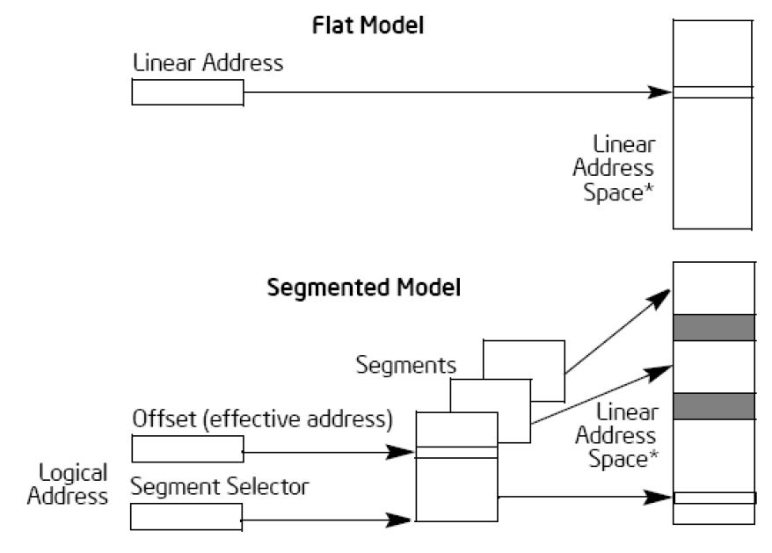
Segmentation/Paging
Simple Segmentation
In Pentium systems
CPU generate logical addresses
Segmentation unit produces a linear address
Paging unit generates physical address in memory
(Equivalent to an MMU)
logical
address
linear
address
physical
address
CPU
Segmentation
Unit
Paging
Unit
Physical
Memory

Slide 29

Notes:
Paul Roper
29

